Slide 1
Facial Action Unit Occurrence to Arousal-Valence in Generative Adversarial Networks

Slide 2
Introduction
To generate and manipulate facial expressions.
FACS
Arousal and Valence
Core Areas:
Identity Representation
Expressions Representation
Three Logical steps:
Separating Identity and expression information in a face
Learning to generate identity and expression representation
Combining the identity and expression representation to generate image

Slide 3
Basic Machine Learning
Classifier
Auto-Encoder
Generative Adversarial Network

Slide 4
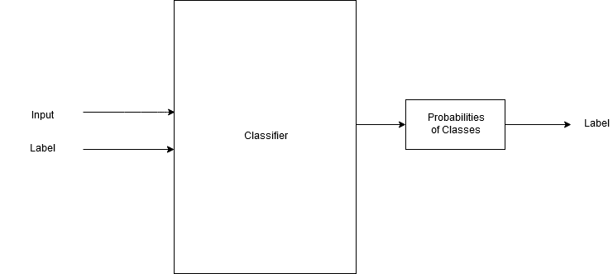
Classifier

Slide 5
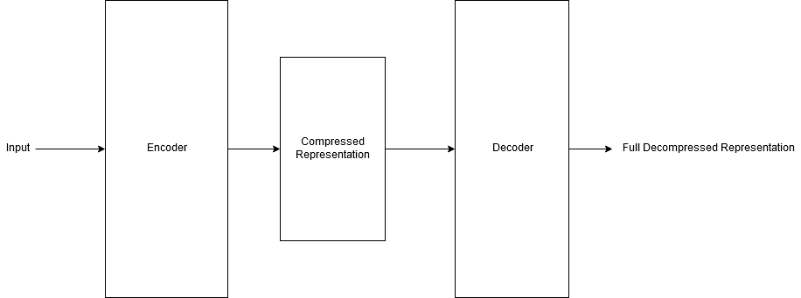
Auto-encoder

Slide 6
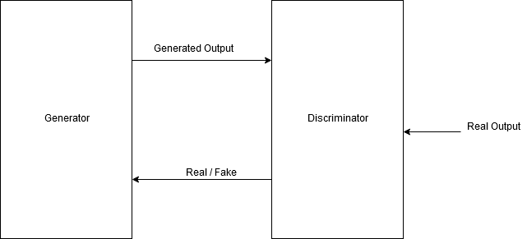
Generative Adversarial Network

Slide 7
Previous Works-ExprGAN
Working
Architecture
Intensity generation
Disadvantage
No clear relation between intensity and encoded expression identity
Cannot change part of face separately

Slide 8
Previous Works-AttrGAN
Working
Architecture
Facial attribute manipulation
Disadvantage
Lack of ability to manipulate attributes.

Slide 9
Motivations
Finding relationship between the learning from networks and real-life objects.
Lack of data on Arousal and Valence

Slide 10
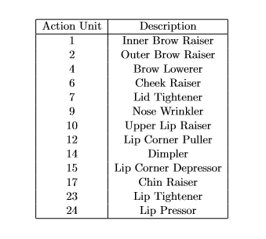
Facial Action Units System
Action Unit 6
Action Unit 12
Happiness
Gif source: https://imotions.com/blog/facial-action-coding-system/

Slide 11
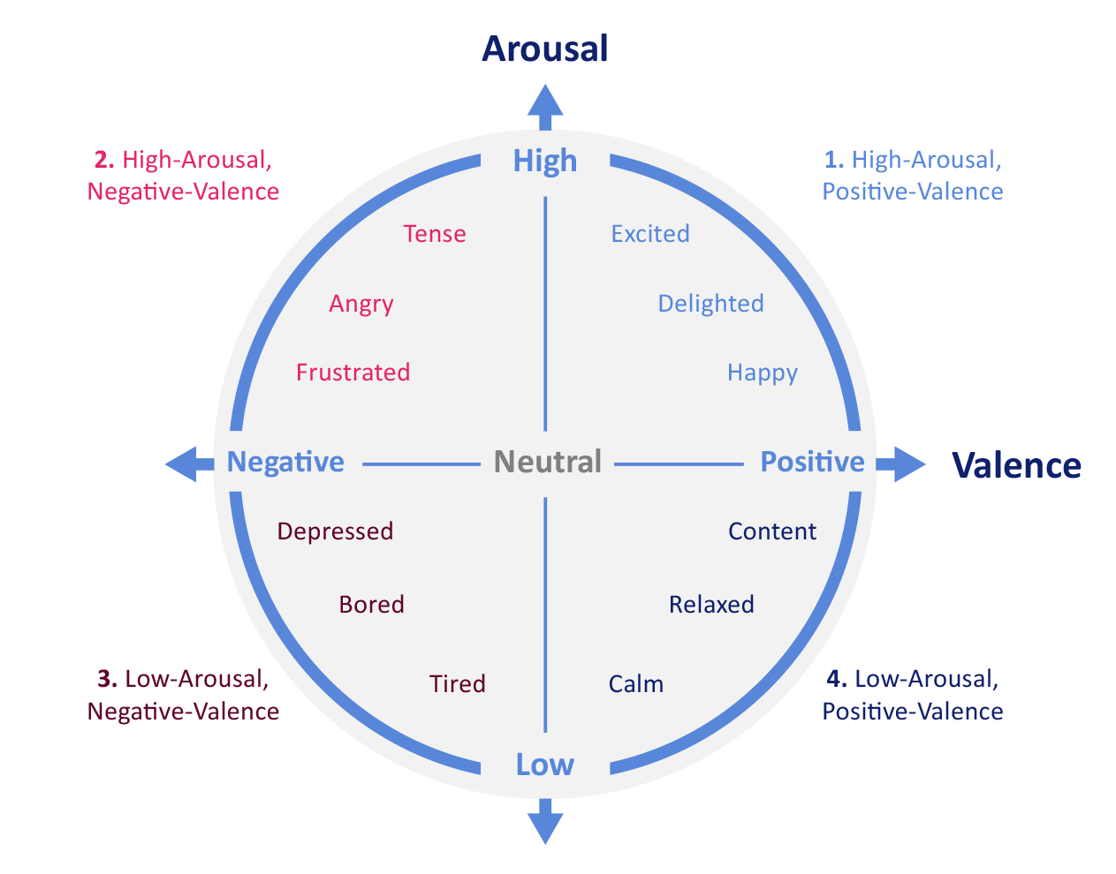
Arousal and Valence
Image source: https://www.powerpost.digital/insights/why-emotions-are-crucial-in-brand-publishing/

Slide 12
Approach
Two way process
1. Generating Identity Representation
2. Generating Expression Representation
Combining The Two to generate image.

Slide 13
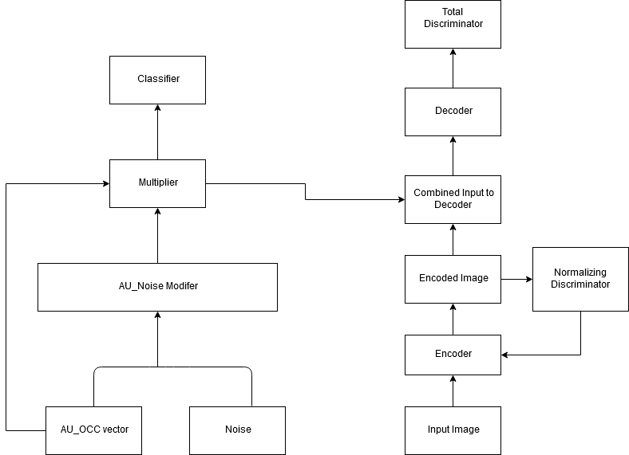
Architecture

Slide 14
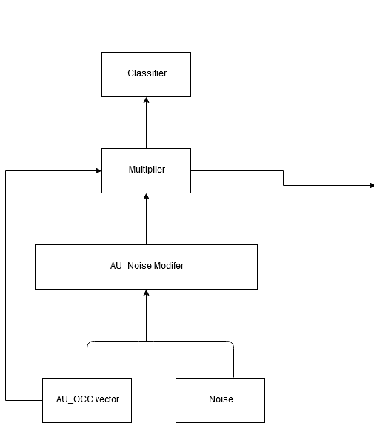
Classifier
Purpose
To create latent space
for action unit representation.
AU_OCC vector
AU_Noise Modifier
Multiplier
Classifier

Slide 15
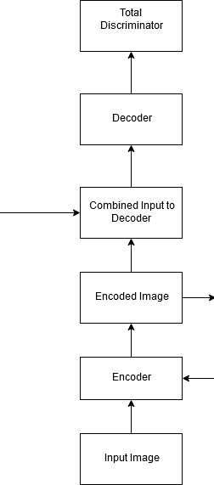
Auto-Encoder
Purpose
To generate and learn
identity representation.
To combine identity representation
and expression representation

Slide 16
Discriminators
Normalizer Discriminator
Populating the latent space for identity representation.
Total Discriminator
Improving the quality of image generated by discriminator.

Slide 17
Dataset
Dataset used in the project is BP4D. The dataset contains has model data of 41 subjects female or male subjects. Each subject has image data related to 8 tasks.
8 Tasks are used to evoke 8 expressions – Happiness, Sadness, Surprise, Embarrassment, Fear or Nervous, Physical Pain, Anger, Disgust.
Action Units Occurrence Vector.

Slide 18
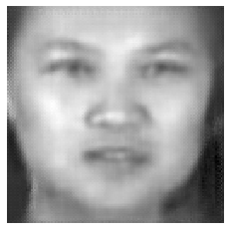
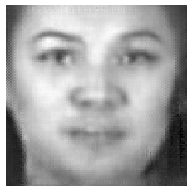
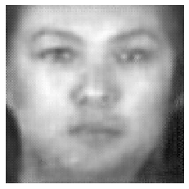
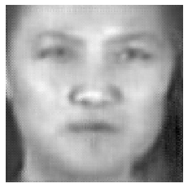
Experiments
Changing one action unit at a time to a image
Original generated image with original action units
Removing Lid Tightner
Added Lip Presser
Chin Raiser

Slide 19
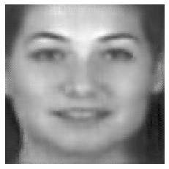
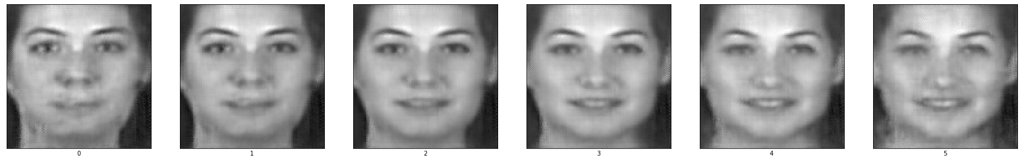
Experiments - Series Images
Increasing and decreasing values for all original present action units at the same time.
Original Action Unit
Series Image

Slide 20
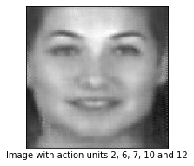
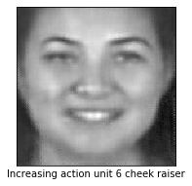
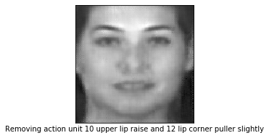
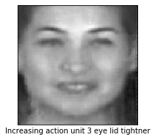
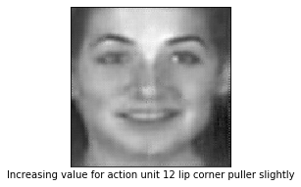
Experiments – Variations of the same expressions

Slide 21
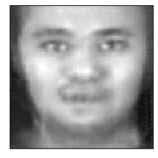
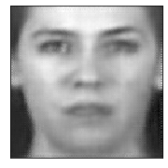
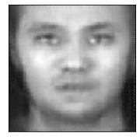
Experiments – Transfer action units from one image to another
Target Identity Representation
Target Expression Representation
Target Identity and Expression Representation

Slide 22
Experiments – Manipulating Arousal and Valence
Each combination of action units have certain arousal and valence values generated as probability from Arousal and valence classifier.
Multiplying the values of action units by negative and positive values to AU_OCC vector manipulates arousal and valence values which also results in modified corrected AU_OCC vectors output of multiplier.

Slide 23
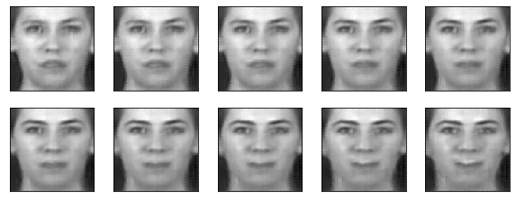
Experiments – Manipulating Arousal and Valence
Decreasing arousal and increasing valence from left to right

Slide 24
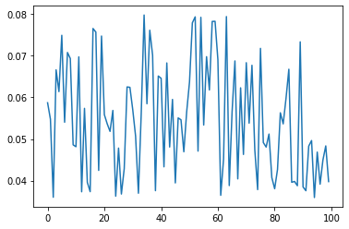
Experiment – Values of Action Units and combination
Checking values of individual action units based on their combination.
Values of action unit 6 alone. Range of values from 0.04 to 0.08

Slide 25
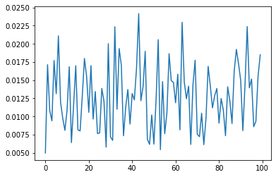
Experiment – Values of Action Units and combination
Values of action unit 6 with combination of action units 7. Range of values from 0.005 to 0.025

Slide 26
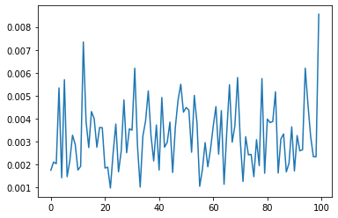
Experiment – Values of Action Units and combination
Values of action unit 6 with combination of action units 7, 10,14 and 23. Range of values from 0.001 to 0.008

Slide 27
Conclusion
The project demonstrates the ability to separate identity and expression representation.
We are also able to generate values for action units and combine them with identity representation to generate image with expressions different from original image.
It also manages to create a relationship between intensity of expressions and arousal and valence classification by the way of changing action unit values.
The project can be improved in its ability to generate sharper images by training on colored images and more number of subjects.

